Slide 1

CUSTOMER SATISFACTION AND FEEDBACK DASHBOARD
- Yeshwanth Reddy

Slide 2


Slide 3
Objectives of Dataset
After analyzing the data, I have made some objectives and the objectives are
Sum of Sales revenue upon year.
Sum of sales revenue based on region in map chart.
Total No. of products delivered On-time.
Total No. of customers return back their product.
Total No. of customers bought their product through which acquisition type.
State-wise Acquisition type.
Customer feedback.

Slide 4
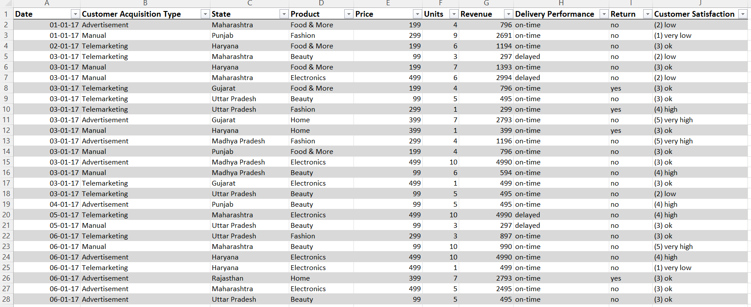
Dataset

Slide 5
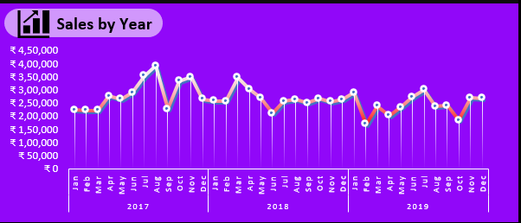
Analysis of Dataset
1.Sum of Sales revenue upon year
From dataset I need to analyze the data of the sales revenue row for every month in 3 years.
From Dataset I did the following:
Select Dataset <<Click on insert <<Select pivot Table.

Slide 6
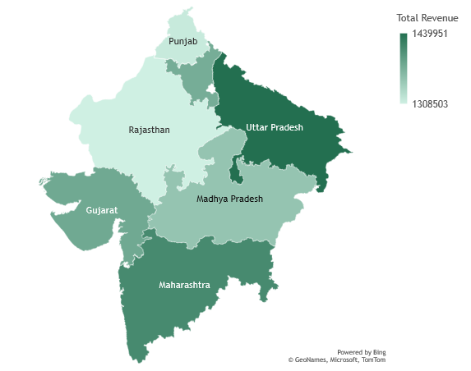
2. Sum of sales revenue based on region in map chart.
From dataset I created another pivot table for analyses of the total revenue from each state.
I added state in the columns field and revenue (total as sum) in value field.
I copied the value of Pivot table and paste at desired position in dataset because we cannot directly make a map graph using pivot table.
 | Punjab | Rajasthan | Gujarat | Madhya Pradesh | Uttar Pradesh | Maharashtra | Haryana
Total Revenue | 1314385 | 1308503 | 1381150 | 1353090 | 1439951 | 1412456 | 1376333

Slide 7
3(a). Total No. of products delivered On-time.
For analysis of Total no of products deliveries delivered on time.
For this analysis I used percentage as value for graph and graph is a donut graph.
3(b). Total No. of customers return back their product
Same as the above graph I need to analyze the total no. of customers returned their product back(yes/no).
 | Sum of Units
on-time | 21235
Delayed | 10497
Grand Total | 31732
Row Labels | Count of Revenue
no | 5184
yes | 596
Grand Total | 5780
67%
10%

Slide 8
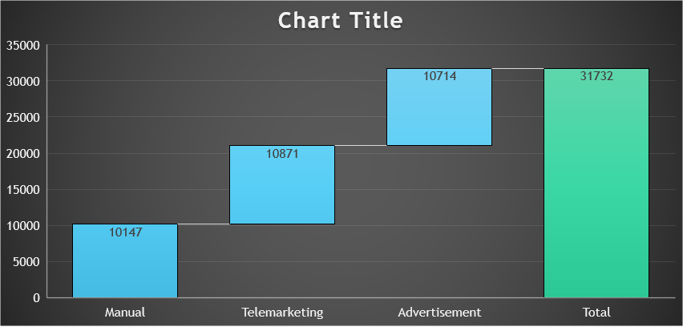
4.Total No. of customers bought their product through which acquisition type.
For analysis of no. of customers bought their product through which acquisition type.
Created a pivot table with Customer acquisition type in row field and units in the value field as sum.
I want to create a different chart model so I choose waterfall graph, but we can’t make a graph using pivot table. So, I again copied the values of pivot using GETPIVOTDATA function and I created a waterfall graph.

Slide 9
5.State-wise Acquisition type.
For analysis of state-wise acquisition type I created the bar graph for easy analysis of which state has maximum customers buying products through which acquisition type.
Sum of Units | Column Labels
Row Labels | Advertisement | Manual | Telemarketing | Grand Total
Gujarat | 1541 | 1452 | 1557 | 4550
Haryana | 1622 | 1343 | 1602 | 4567
Madhya Pradesh | 1482 | 1473 | 1455 | 4410
Maharashtra | 1524 | 1620 | 1600 | 4744
Punjab | 1580 | 1403 | 1332 | 4315
Rajasthan | 1468 | 1380 | 1549 | 4397
Uttar Pradesh | 1497 | 1476 | 1776 | 4749
Grand Total | 10714 | 10147 | 10871 | 31732

Slide 10
6.Customer feedback
For analysis like feedback, bar or column stacked graph is good for analysis.
I added product in row field and customer feedback in column and revenue as count in value field of Pivot table fields.
Count of Revenue | Column Labels
Row Labels | (1) very low | (2) low | (3) ok | (4) high | (5) very high | Grand Total
Beauty | 123 | 200 | 459 | 240 | 113 | 1135
Electronics | 109 | 198 | 509 | 231 | 114 | 1161
Fashion | 133 | 231 | 421 | 249 | 119 | 1153
Food & More | 126 | 248 | 445 | 249 | 92 | 1160
Home | 106 | 243 | 474 | 244 | 104 | 1171
Grand Total | 597 | 1120 | 2308 | 1213 | 542 | 5780

Slide 11
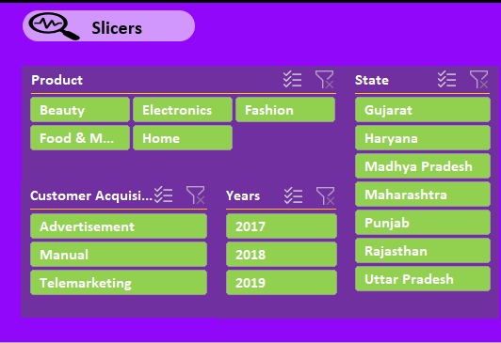
SLICERS
I added few slicers to filter the dashboard like product, state, years, and customer acquisition type.
I also changed slicer styles which suits by background of my dashboard.

Slide 12
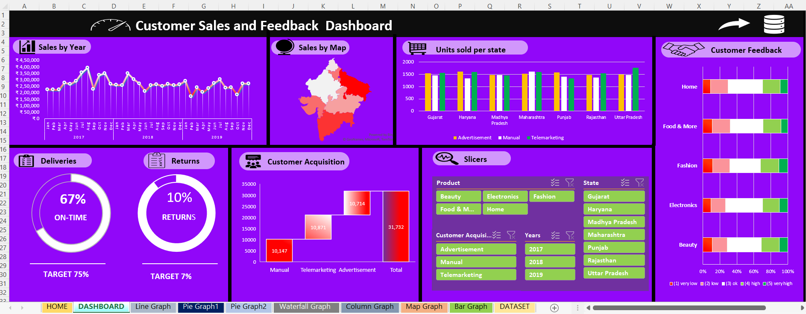
Dashboard

Slide 13
References
www.kaggle.com
www.youtube.com
www.data.gov.in
www.amazondatasets.com

Slide 14

Thank you

